Slide 1
Laptop Analysis
By : ANURIYA RAVEENDRAN
Batch : DA/DS
Milestone 1 : python data exploration project date : 20 /01/2025

Slide 2
CONTENTS :
INTRODUCTION
AIM
METHODOLOGY
EDA VISUALIZATION
Colab link : https://colab.research.google.com/drive/1JzK21dsuFRpX1GC4-yjMaPCvofVtnodT?usp=sharing

Slide 3
INTRODUCTION :
This laptop dataset contains detailed information about 1,303 laptops, including specifications such as brand, type, screen size, resolution, CPU, RAM and price etc.
It offers a valuable opportunity to explore trends in laptop configurations and pricing. The data can be used to analyze how various features influence price and identify popular configurations across brands.
With some columns having missing values, preprocessing is essential before analysis. Potential objectives include studying market trends, or identifying key specifications that affect consumer preferences. This dataset provides rich insights for machine learning and data-driven decision-making projects.

Slide 4
AIM :
The aim of this project is to analyze the laptop dataset to understand the relationship between various specifications (e.g., brand, CPU, RAM, screen resolution) and their impact on price.
By uncovering trends and insights, this analysis can help consumers make informed purchasing decisions and provide manufacturers with valuable market intelligence

Slide 5
METHODOLOGY :
Data understanding
Data cleaning
Data analysis

Slide 6
DATA SET :
Unnamed: 0 | Company | TypeName | Inches | ScreenResolution | Cpu | Ram | Memory | Gpu | OpSys | Weight | Price
0 | Apple | Ultrabook | 13.3 | IPS Panel Retina Display 2560x1600 | Intel Core i5 2.3GHz | 8GB | 128GB SSD | Intel Iris Plus Graphics 640 | macOS | 1.37kg | 71378.68
1 | Apple | Ultrabook | 13.3 | 1440x900 | Intel Core i5 1.8GHz | 8GB | 128GB Flash Storage | Intel HD Graphics 6000 | macOS | 1.34kg | 47895.52
2 | HP | Notebook | 15.6 | Full HD 1920x1080 | Intel Core i5 7200U 2.5GHz | 8GB | 256GB SSD | Intel HD Graphics 620 | No OS | 1.86kg | 30636
3 | Apple | Ultrabook | 15.4 | IPS Panel Retina Display 2880x1800 | Intel Core i7 2.7GHz | 16GB | 512GB SSD | AMD Radeon Pro 455 | macOS | 1.83kg | 135195.3

Slide 7
DATA UNDERSTANDING :
No of rows : 1,303
No of columns : 12
Data type : float , object .

Slide 8
Feature Engineering :
Feature engineering is the process of transforming raw data into meaningful and informative features that improve the performance of machine learning models.
Handling missing values
Outlier detection
New feature creation

Slide 9
Data Exploration :
There is missing values in each column
Company | 30
TypeName | 50
Inches | 83
ScreenResolution | 30
Cpu | 30
Ram | 44
Memory | 30
Gpu | 30
OpSys | 30
Weight | 44
Price | 30

Slide 10
Handling missing values
The method of dealing with missing values by filling numerical columns with the median and categorical columns with the mode is referred to as Imputation.
Median Imputation: For numerical columns, replacing missing values with the median is a robust method as it is not affected by outliers.
Mode Imputation: For categorical columns, replacing missing values with the mode ensures the most frequent category is used.
This combined approach is often referred to as Median-Mode Imputation or Simple Imputation in data preprocessing.

Slide 11
Outlier detection :
Outliers are detected by IQR method
Q1=25th percentile of the data
Q3=75th percentile of the data
Lower Bound= Q1− 1.5 × IQR
Upper Bound= Q3 + 1.5 × IQR
IQR = Q3 – Q1

Slide 12
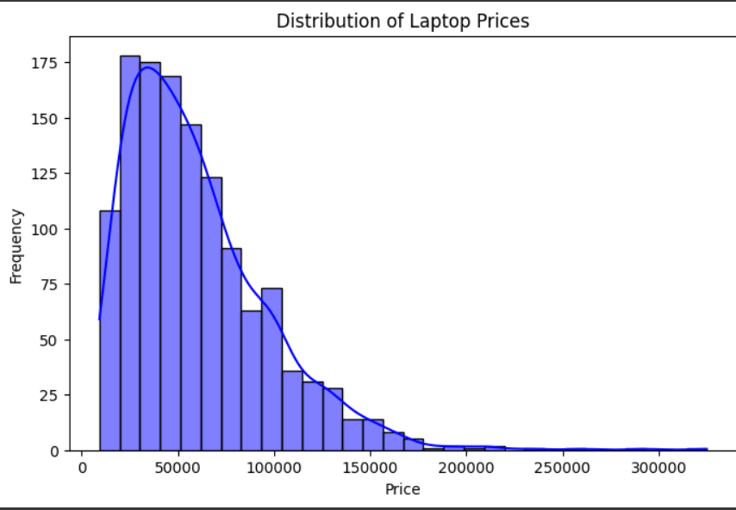
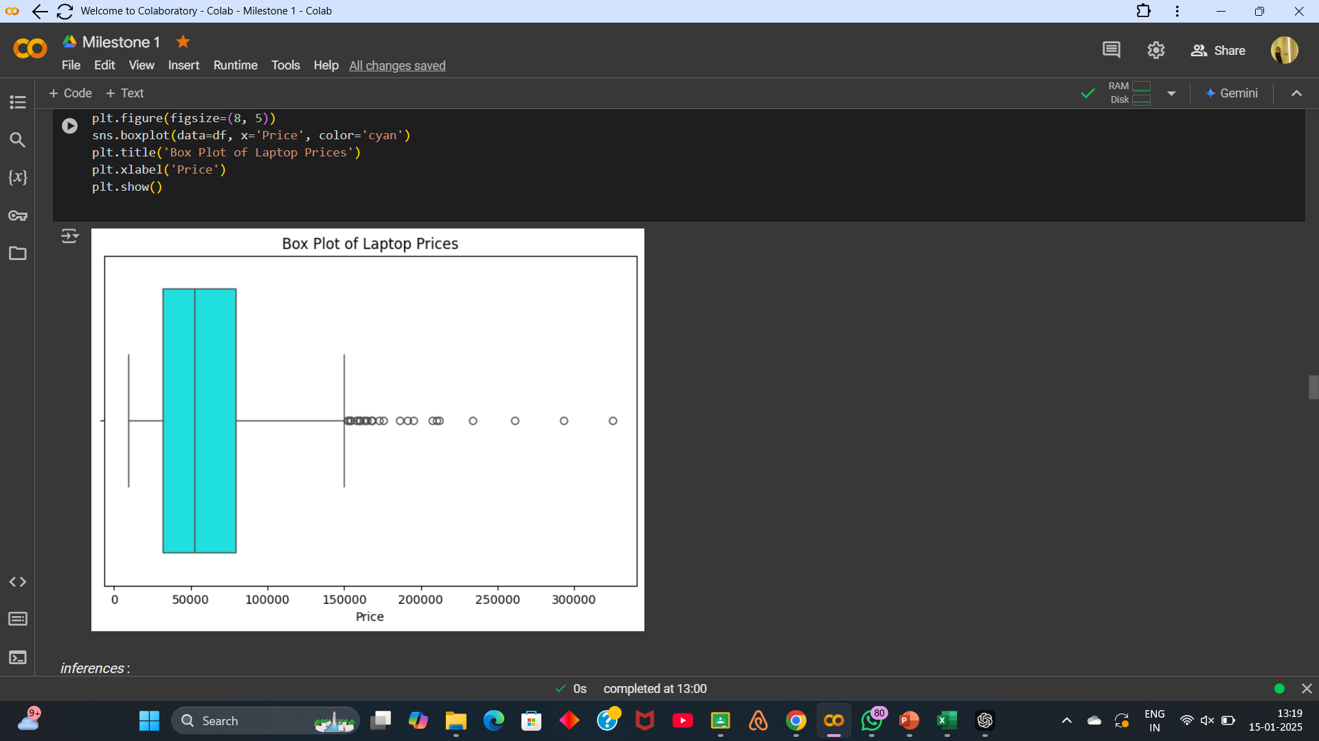
DATA VISUALIZATION :
UNIVARIANT ANALYSIS :

Slide 13
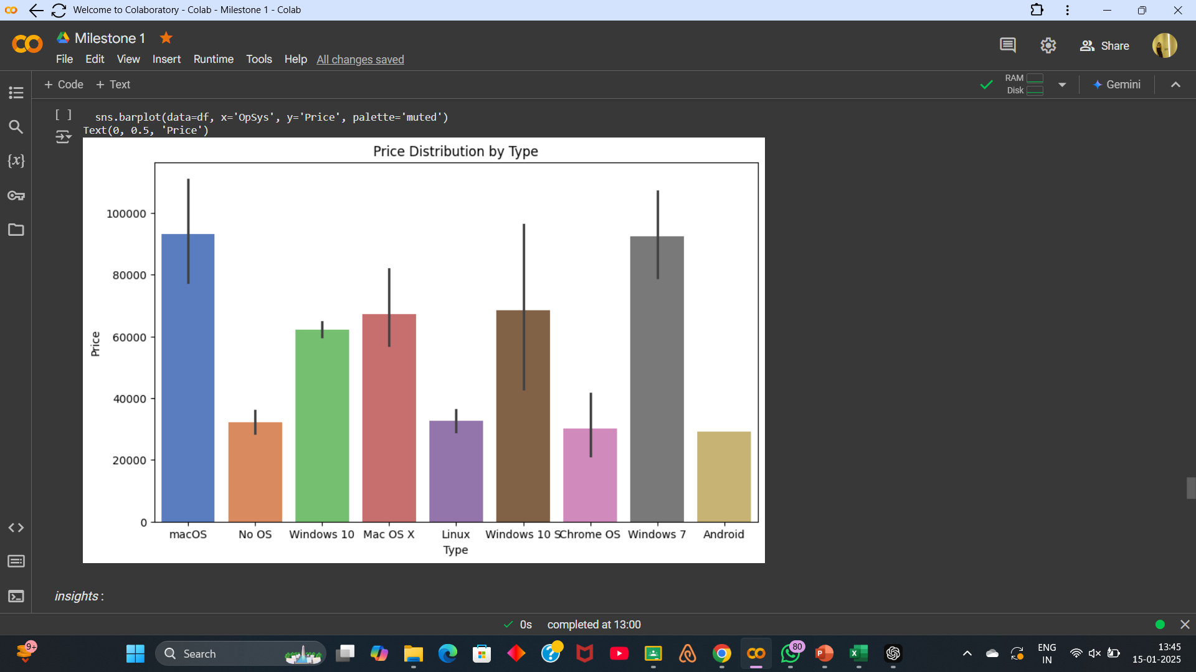
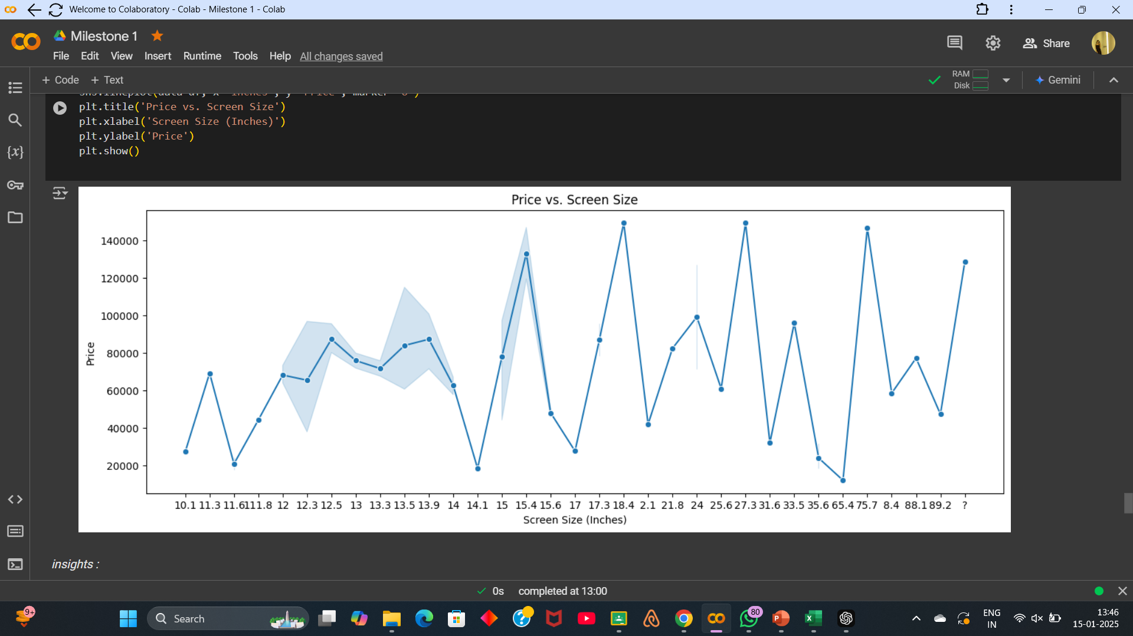
BIVARIANT ANALYSIS:

Slide 14
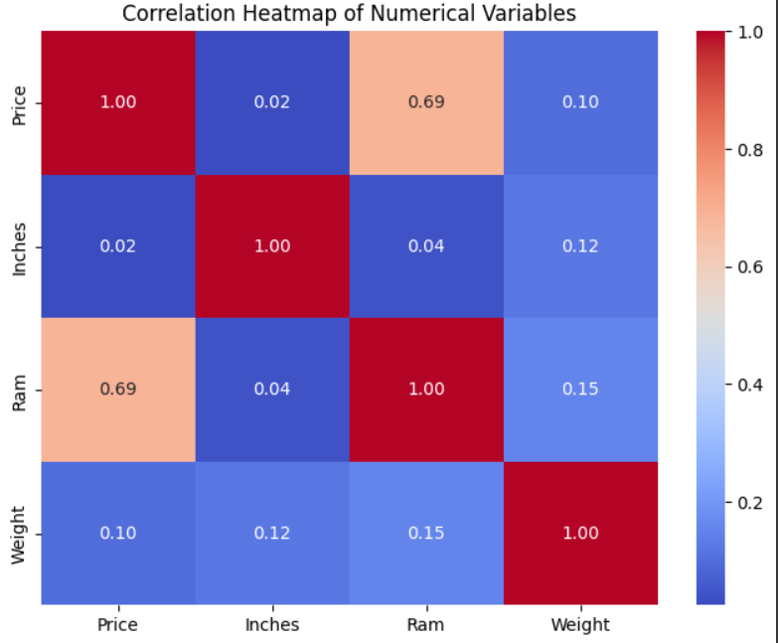
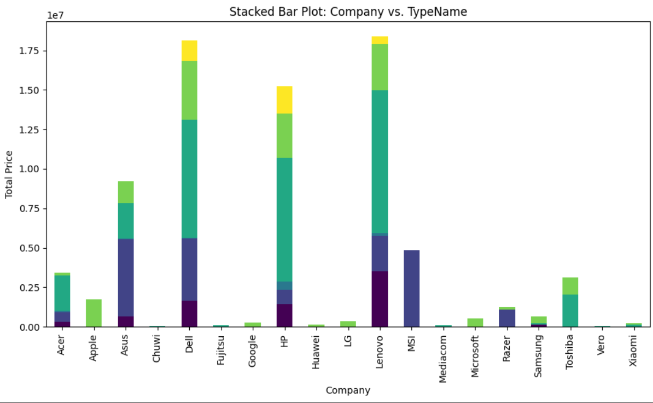
MULTIVARIANT ANALYSIS :

Slide 15
Conclusion & Results :
Price Influencers:
RAM size and Screen size (Inches) are significant drivers of laptop price. Larger RAM and screen sizes generally lead to higher prices, indicating their importance in performance and usability.
Brand dominance
Certain brands like Apple focus exclusively on premium laptops (e.g., ultrabooks), while others like HP, Dell, and Lenovo offer diverse options catering to various customer needs.
Correlation Insights:
High positive correlations between Price, RAM, and Screen Size highlight the critical role of these factors in determining laptop value. Weight has a moderate influence, reflecting design considerations.
Operating System Trends:
Windows OS dominates the market due to its versatility and broad application range. Other OS options, like MacOS and Linux, cater to niche or premium segments.
Opportunities for Growth:
Brands can expand offerings in underrepresented types (e.g., gaming laptops for non-specialized brands) or explore lightweight, high-performance models for premium customers

Slide 16
Thank you !

